Slide 1
Bike Share Report
Presented By :- Smit Gol
Last Updated :- 28 August 2021

Slide 2
Table of Contents
Bike Share
Purpose Statement(what we are talking about ?)
Story about Data
Conclusion
Appendix

Slide 3
Objective
Identify, how annual member bike ride are different from casual riders

Slide 4
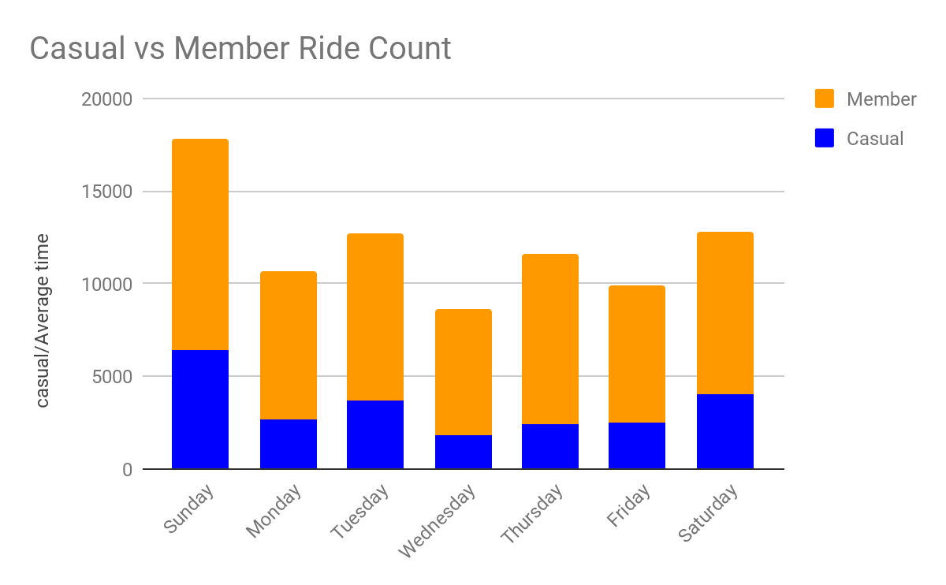
Bike Ride comparison

Slide 5
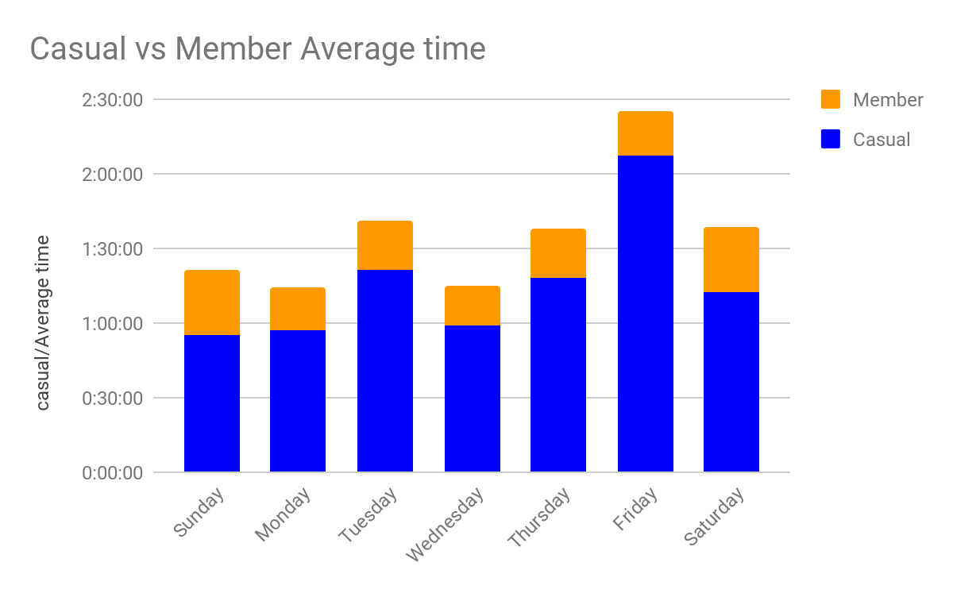
Average Time Comparison

Slide 6
Conclusions
Annual member takes Average time of Annual
More rides compared member is less
to Casual riders compared to
Casual rider
Hence, We can conclude that Annual membership is more profitable then
Casual rides
1
2

Slide 7
Appendix
Annual Member :- Customer registered with one year membership on our platform
Casual Member :- Customer pay as per total distance travelled in single ride

Slide 8
Thank you

